Slide 1
The Siege of Leningrad
900 days …

Slide 2
…in June 1941, the population of Leningrad was about 2,500,000.
on September 12th, those in charge of the city estimated that they had the following supplies:
flour for 35 days
cereals for 30 days
meat for 33 days
fats for 45 days
sugar for 60 days

Slide 3
In November 1941, while the siege was in its early stages, 11,000 people died of what the authorities called 'alimentary dystrophy' (starvation) - over 350 a day. However, this number greatly increased as the winter took a hold on the city.
"I watched my father and mother die - I knew perfectly well they were starving. But I wanted their bread more than I wanted them to stay alive. And they knew that about me too. That's what I remember about the blockade: that feeling that you wanted your parents to die because you wanted their bread."

Slide 4
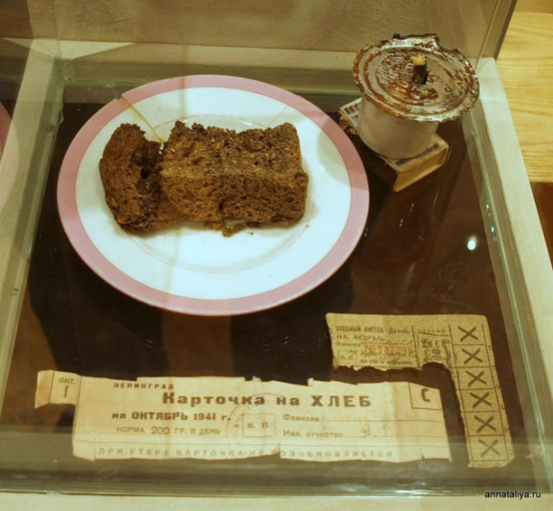
Rations were down to half a pound of bread a day, and very little else.
'Bread' baked by bakers even in the first few months of the siege contained only 50% rye flour. To boost the loaf, soya, barley and oats were used. However, the oats were meant to feed horses and malt was used as an alternate substitute. Even cellulose and cottonseed were tried in an effort to produce bread. Both had little nutritional value but there was plenty of both in Leningrad.

Slide 5
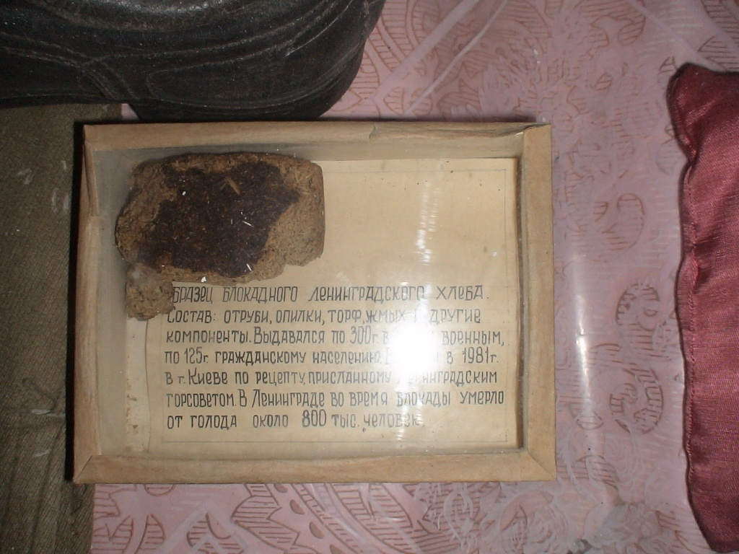
Bran, sawdust, peat, mill cake

Slide 6
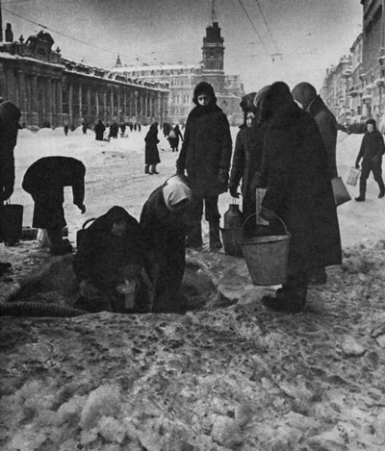
In the city …
While the city had a rail network of sorts, Stalin ordered that all vital goods in the city that could help defend Moscow must be moved out of Leningrad to the capital.
Winters in Leningrad were extremely cold.
Lack of fuel meant that the use of electricity in homes was banned - industry and the military took priority.
Kerosene for oil lamps was unobtainable.
Wood became the major source of heat in homes with furniture and floor boards being burned in most homes.

Slide 7
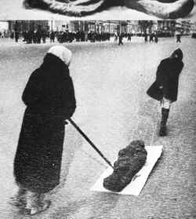
People collapsed in factories and on the streets - and died.
People were only getting 10% of the required daily calorific intake and their work was intensive.

Slide 8
When people died in the street, there was a scramble for their ration card.
125 grams of bread for the whole day…

Slide 9
Tanya Savicheva’s Diary

Slide 10
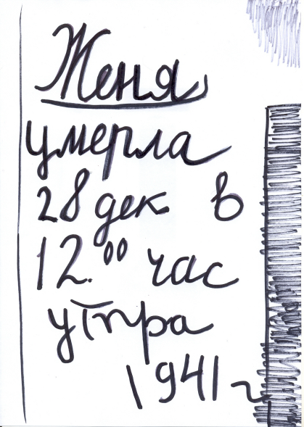

Slide 11
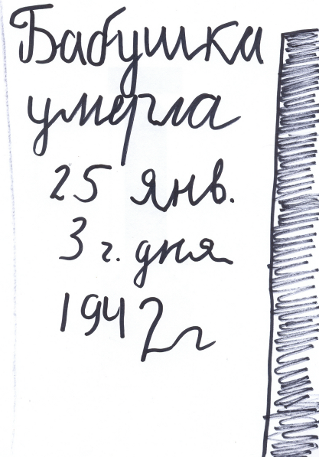

Slide 12
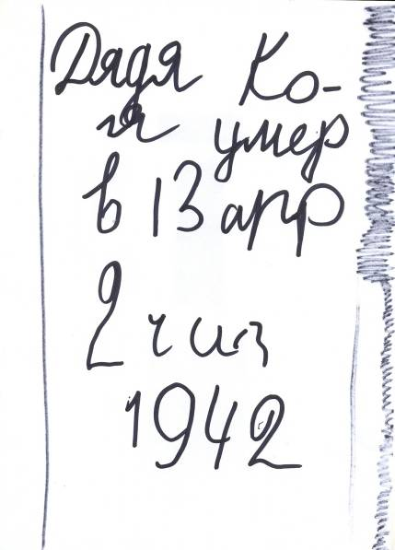

Slide 13
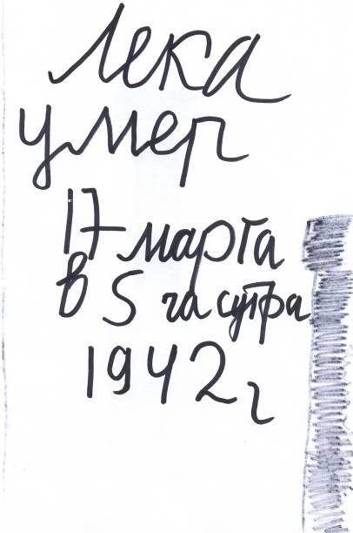

Slide 14
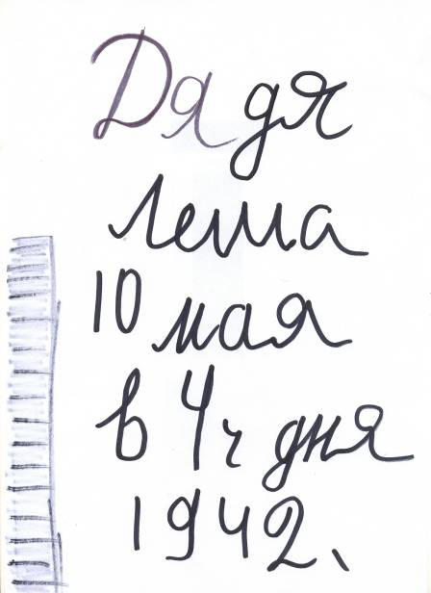

Slide 15
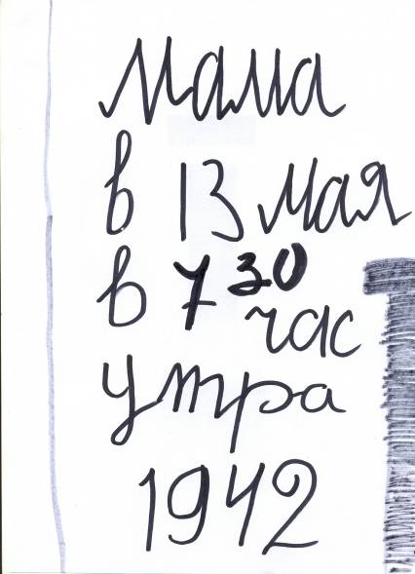

Slide 16
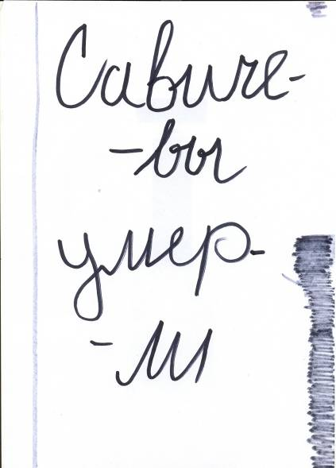

Slide 17
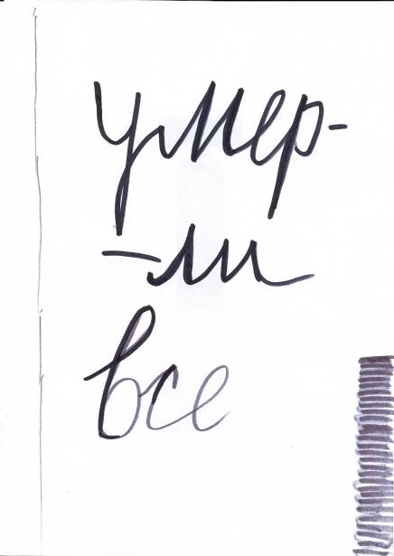

Slide 18
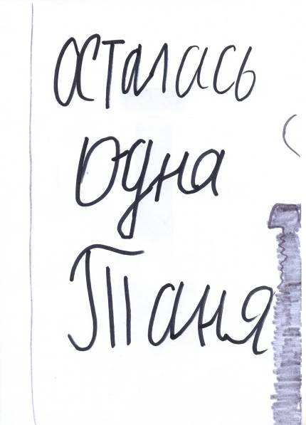

Slide 19
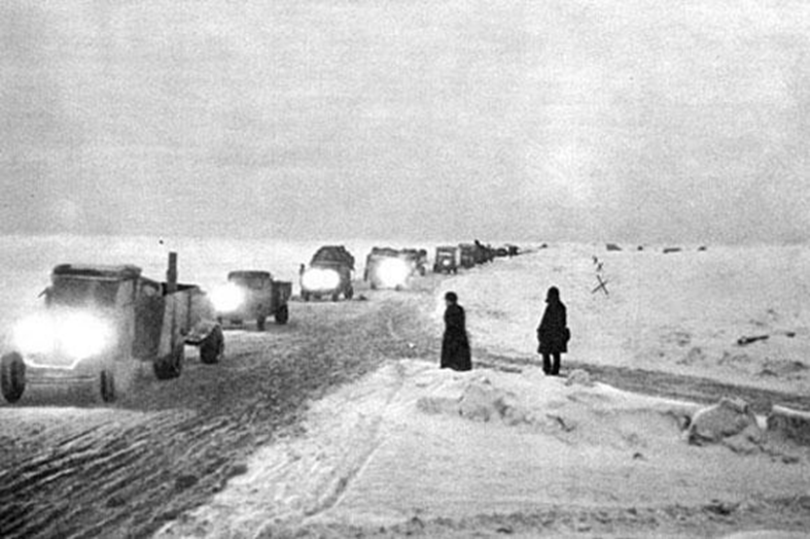
No one is forgotten Nothing is forgotten
Russia will never forget the valour of those who worked on the Way of Life during the heroic defence of Leningrad.
On December 26, 1941, the bread ration in Leningrad was increased.

Slide 20
2014 – the 70 anniversary of the end of the siege of Leningrad
The memory of the people survived in the siege keeps vivid picture and dramatic stories of that time …

